Slide 1

UNEMPLOYMENT IN INDIA
nAgendRA V KINI

Slide 2
OBJECTIVE OF THIS ANALYSIS
* The objective of our project on unemployment in India using Power BI could be to analyze and visualize the multifaceted nature of unemployment in India.
* By leveraging Power BI's capabilities, We aim to delve into various aspects such as regional disparities, sectoral trends, demographic patterns, and policy impacts. Our goal is to provide a comprehensive understanding of the current state of unemployment in India, identify key drivers, and potentially uncover insights that can inform policymakers, stakeholders, and organizations in developing effective strategies to mitigate unemployment challenges and foster inclusive economic growth.
Tools Used to Analyze This Project :- Power BI

Slide 3
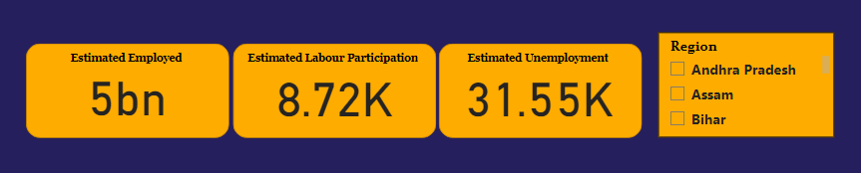
INSIGHT
KPI & FILTER
Estimated Employed :- This represents the estimated number of people currently employed in India, which we’ve calculated to be 5 billion.
Estimated Labor Participation :- This indicates the estimated number of people actively participating in the labor force, which we've calculated to be 8.72k .
Estimated Unemployment :- This represents the estimated number of people who are unemployed in India, which we've calculated to be 31.55k .
Having these metrics allows you to assess the employment situation in India more comprehensively. By analyzing these figures alongside regional data, we can identify trends, disparities, and potential areas for improvement.
KPI
Adding a filter to our dashboard for different regions in India is a smart move. This filter will enable users to drill down into specific geographic areas, allowing for more targeted analysis and comparison across regions. It enhances the usability and relevance of our dashboard, enabling users to gain insights that are tailored to their specific areas of interest or focus.
FILTER

Slide 4
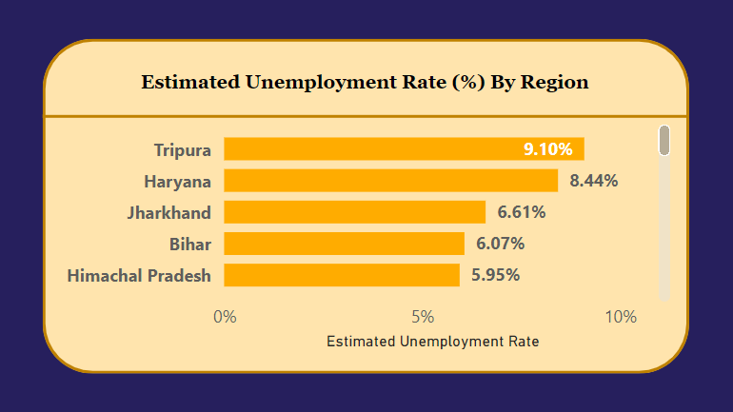
INSIGHT
In my analysis of unemployment in India, I uncovered valuable insights regarding regional unemployment rates. Tripura emerged with the highest unemployment rate at 9.10%, followed closely by Haryana at 8.44%.
Additionally, Jharkhand recorded a rate of 6.61%, while Bihar and Himachal Pradesh reported rates of 6.07% and 5.95%, respectively. These findings shed light on the varying degrees of unemployment across different regions of India.

Slide 5
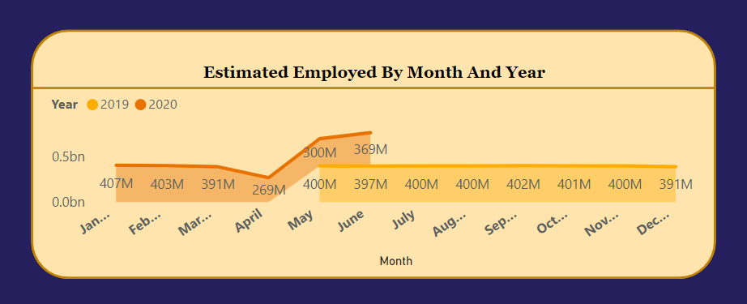
INSIGHT
It's interesting to note that in January 2020, there were approximately 407 million estimated employed individuals in India, compared to September 2019, which had around 402 million estimated employed.
These insights provide valuable information about employment trends over time.

Slide 6
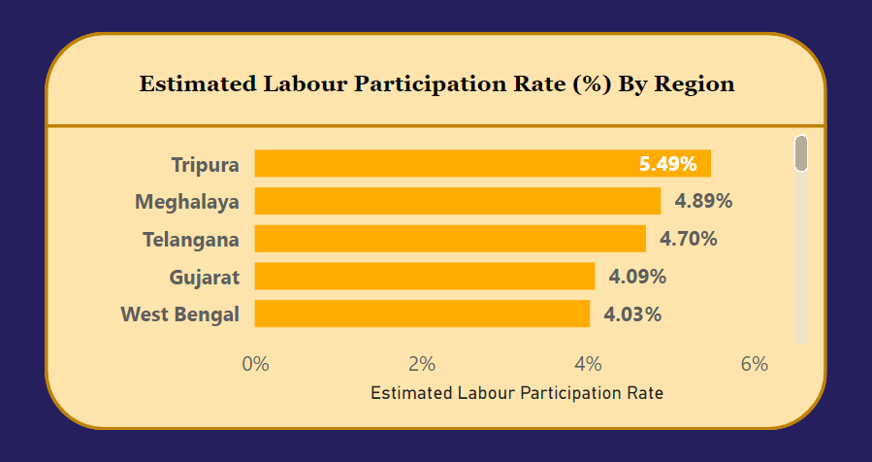
INSIGHT
In my analysis of unemployment in India, I've uncovered insights into the estimated labor participation rates across different regions. Tripura stands out with a labor participation rate of 5.49%, closely followed by Meghalaya at 4.89%. Additionally, Telangana, Gujarat, and West Bengal recorded rates of 4.70%, 4.09%, and 4.03%, respectively.
These findings provide valuable context for understanding the levels of workforce engagement across various regions in India.

Slide 7
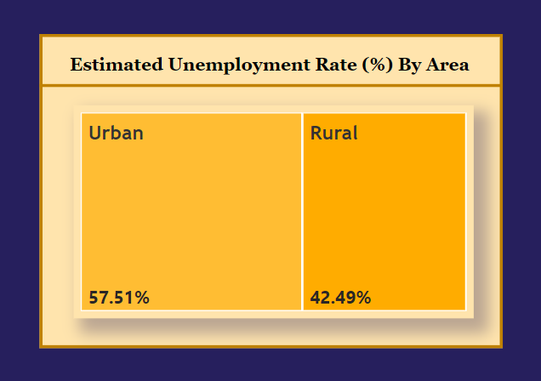
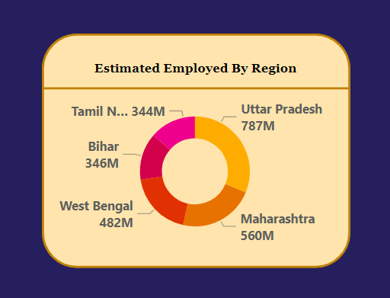
INSIGHT
In my analysis of unemployment in India, I've uncovered insightful data regarding both the estimated unemployment rates categorized by urban and rural areas and the distribution of employed individuals across different regions.
Urban areas exhibit a higher unemployment rate at 57.51%, while rural areas show a slightly lower rate of 42.49%.
Moreover, I've investigated the estimated number of employed individuals by region. Uttar Pradesh leads with 787 million employed individuals, followed by Maharashtra with 560 million, and West Bengal with 482 million. Additionally, Bihar and Tamil Nadu have 346 million and 344 million employed individuals, respectively.
These findings offer a detailed perspective on employment dynamics, highlighting disparities between urban and rural areas as well as the varying employment rates across different regions in India.

Slide 8
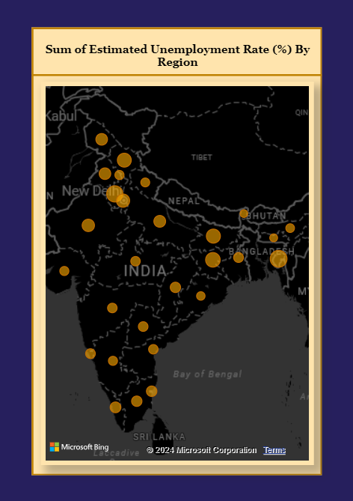
INSIGHT
In my analysis of unemployment in India, I've identified specific regions with notable unemployment rates.
Tripura emerges with the highest unemployment rate, followed by Haryana in second place, Jharkhand in third place, Bihar in fourth place, and Himachal Pradesh in fifth place.
These insights shed light on the regional variations in unemployment across India, providing valuable context for understanding the economic landscape in different areas.

Slide 9
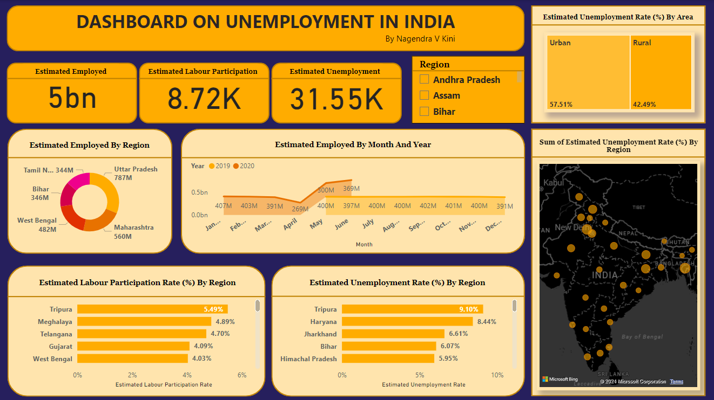
DASHBOARD

Slide 10
RECOMMENDATION
* Targeted Interventions :- Implement focused initiatives to address unemployment in high-risk regions like Tripura, Haryana, Jharkhand, Bihar, and Himachal Pradesh.
* Urban-Rural Balance :- Develop strategies to bridge the gap between urban and rural unemployment rates, considering tailored approaches for each setting.
* Employment Boost :- Prioritize employment generation efforts in states like Uttar Pradesh, Maharashtra, and West Bengal with high employment potential.
* Long-Term Monitoring :- Establish mechanisms for continuous monitoring of employment trends to track progress and inform policy adjustments.
* Collaborative Solutions :- Foster partnerships between government, industry, and civil society to design and implement effective solutions addressing regional disparities in unemployment.
By implementing these recommendations, we can improve employment opportunities in India, leading to enhanced economic growth and prosperity nationwide.

Slide 11
THANK YOU

